Slide 1
Supervised Learning
Fraud detection

Slide 2
What is fraud?
According to Oxford, Fraud a person or thing intended to deceive others, typically by unjustifiably claiming or being credited with accomplishments or qualities.

Slide 3
What is fraud detection?
Fraud detection is a set of activities undertaken to prevent money or property from being obtained through false pretenses. Fraud detection is applied to many industries such as banking or insurance. In banking, fraud may include forging checks or using stolen credit cards. Other forms of fraud may involve exaggerating losses or causing an accident with the sole intent for the payout. - Margaret Rouse, seachsecurity.techtarget.com

Slide 4



background

Slide 5
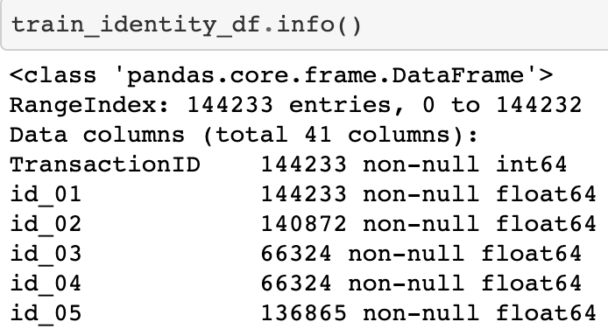
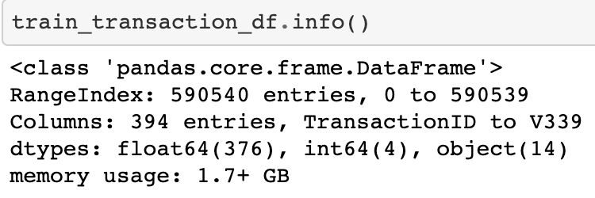
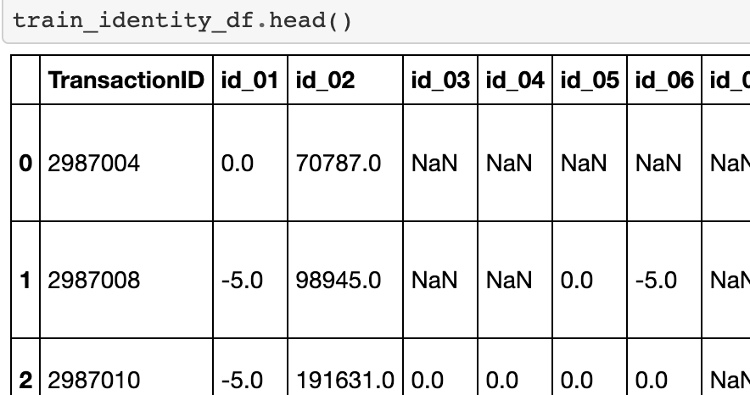
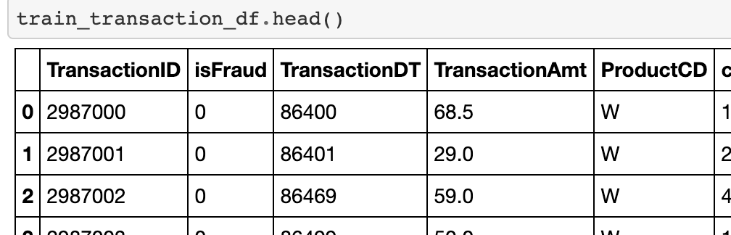
Data discovery
Library Imports
Read CSV
.info()
.head()

Slide 6
Cleaning the data
Looking for empty data or NAN or NULL
Dropped columns
Made a copy of transaction_df

Slide 7
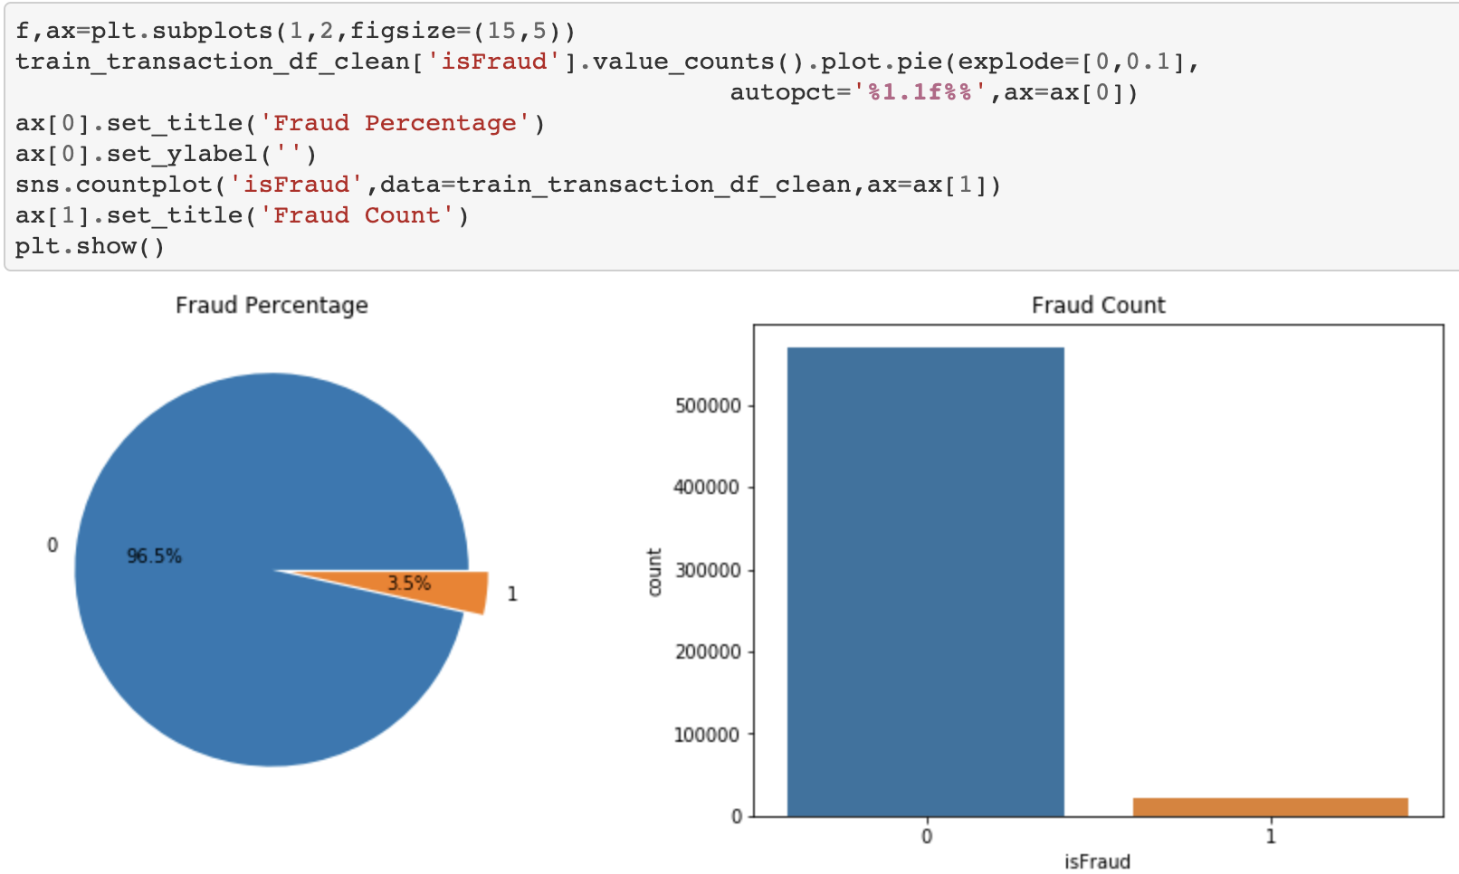
Is fraud?
From our pie chart and bar graph, we have more sample of legit transactions than fraud data.

Slide 8
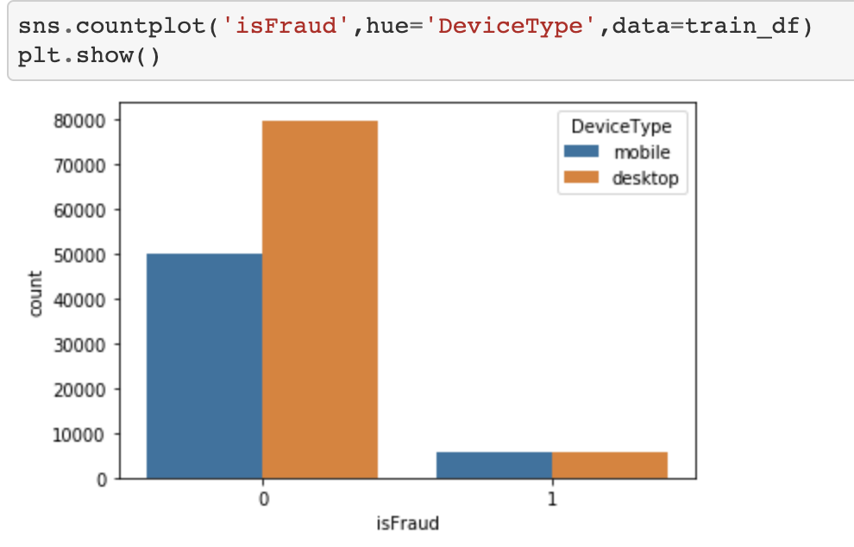
We have almost equal amount of fraudulent data coming from the mobile and desktop side. Criminals do not have a preferred method in committing a crime.
We will now check the correlation between all the data the we have.

Slide 9
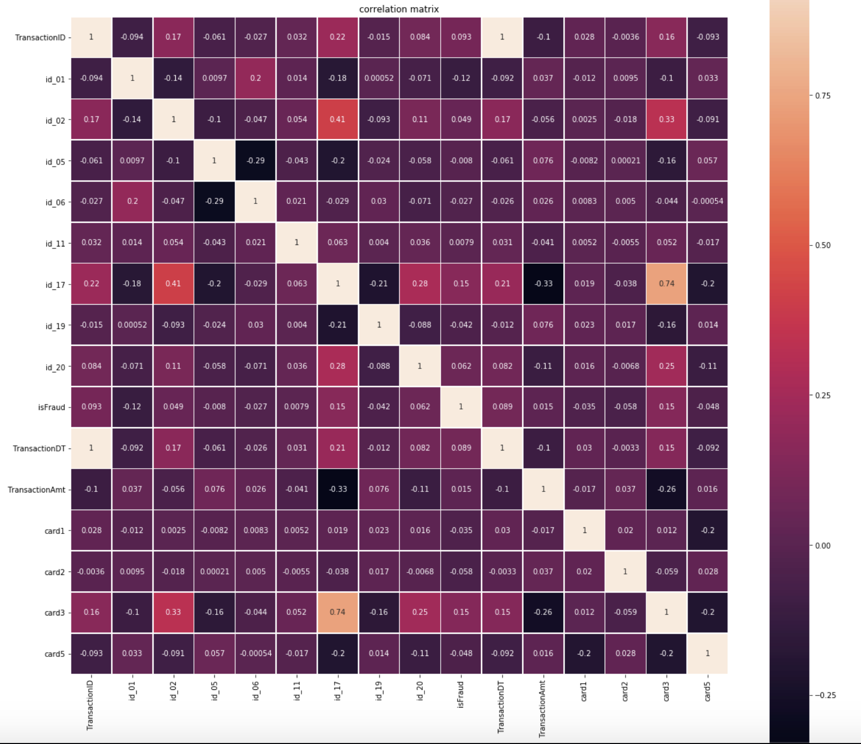
correlation

Slide 10
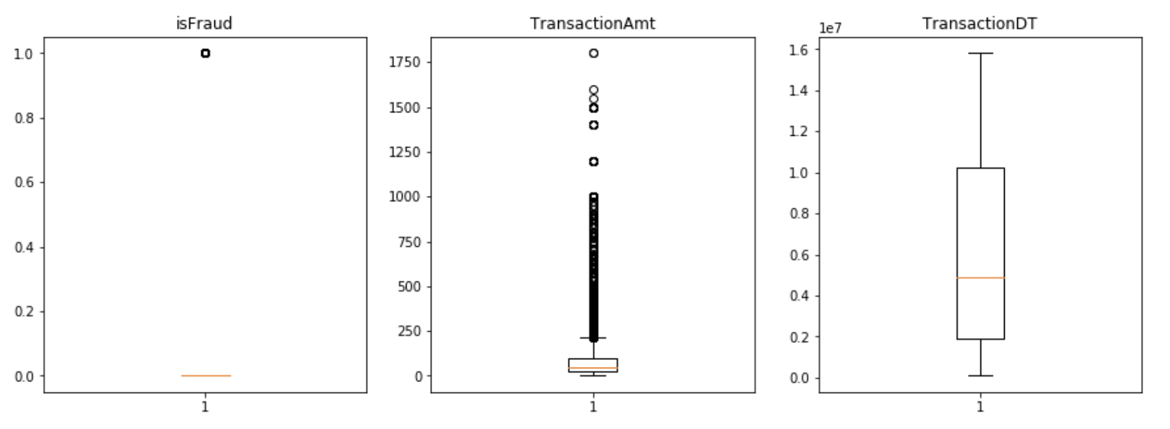
Checking for outliers

Slide 11
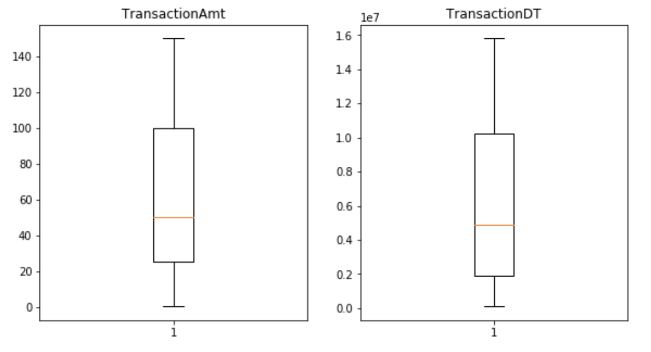

Slide 12
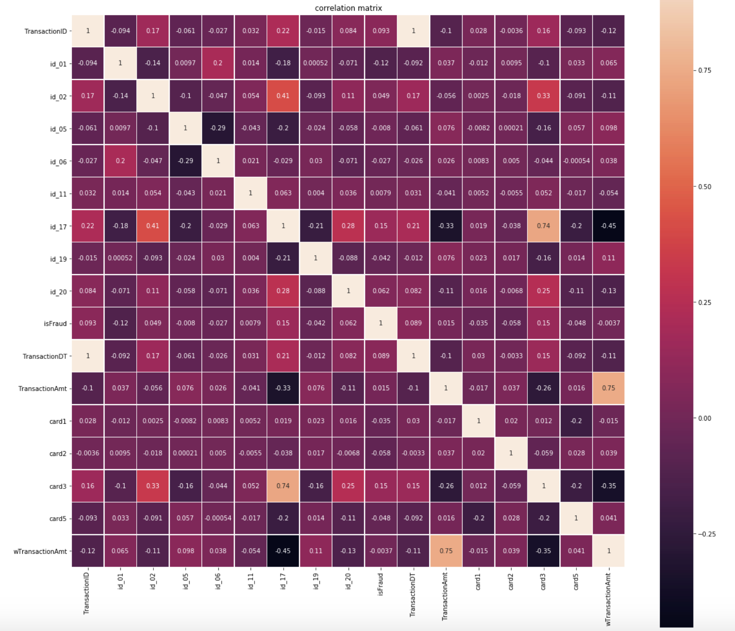

Slide 13
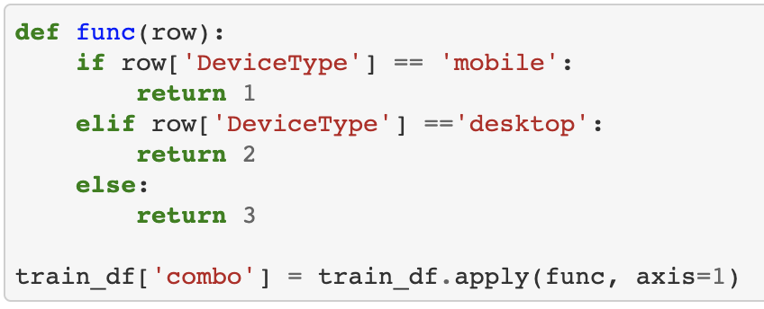
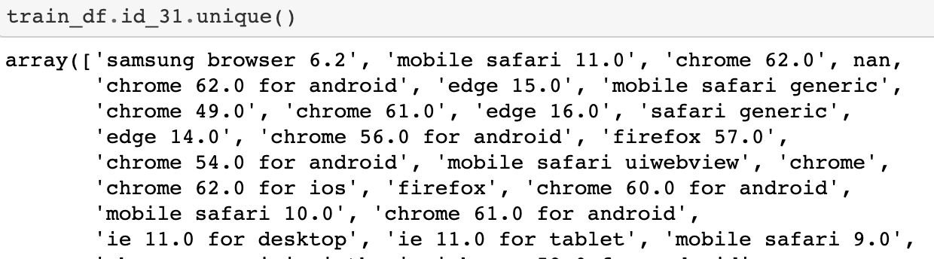
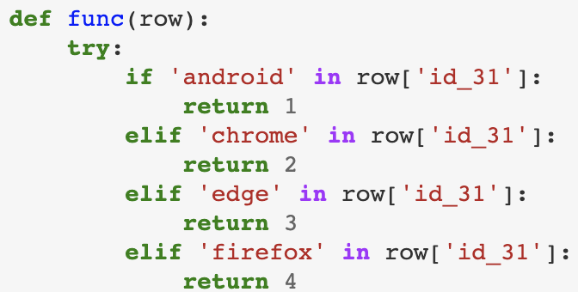
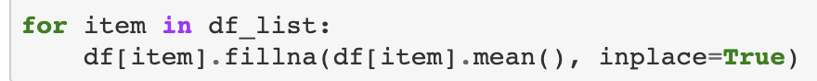
Feature engineering
…more cleaning

Slide 14
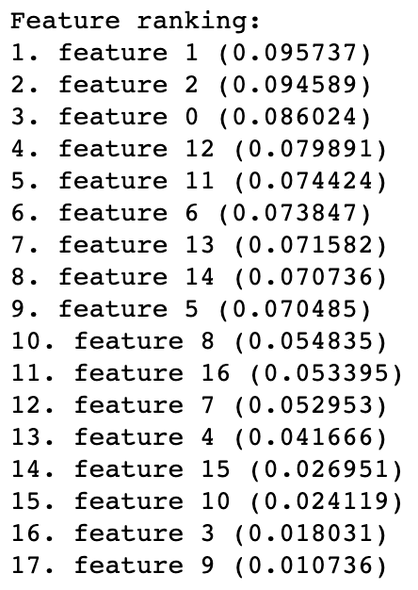
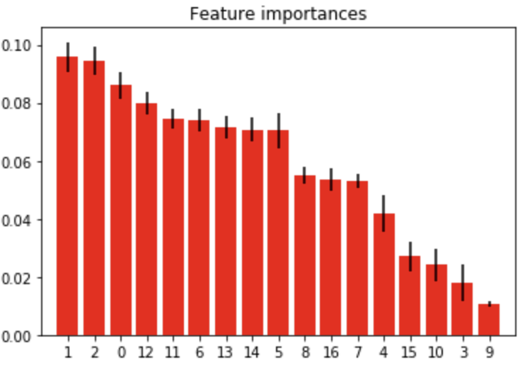
Feature importance

Slide 15
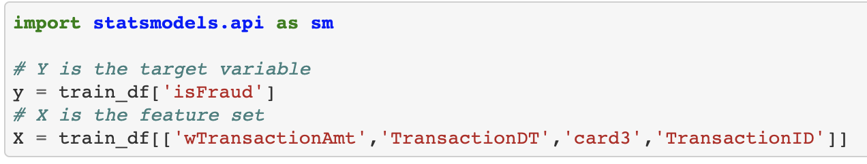
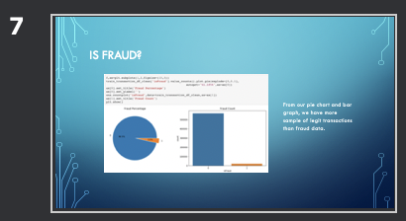
Training data
We need to address our issue of class imbalance

Slide 16
What is over-fitting?
Overfitting refers to a model that models the training data too well.
Overfitting happens when a model learns the detail and noise in the training data to the extent that it negatively impacts the performance of the model on new data.

Slide 17
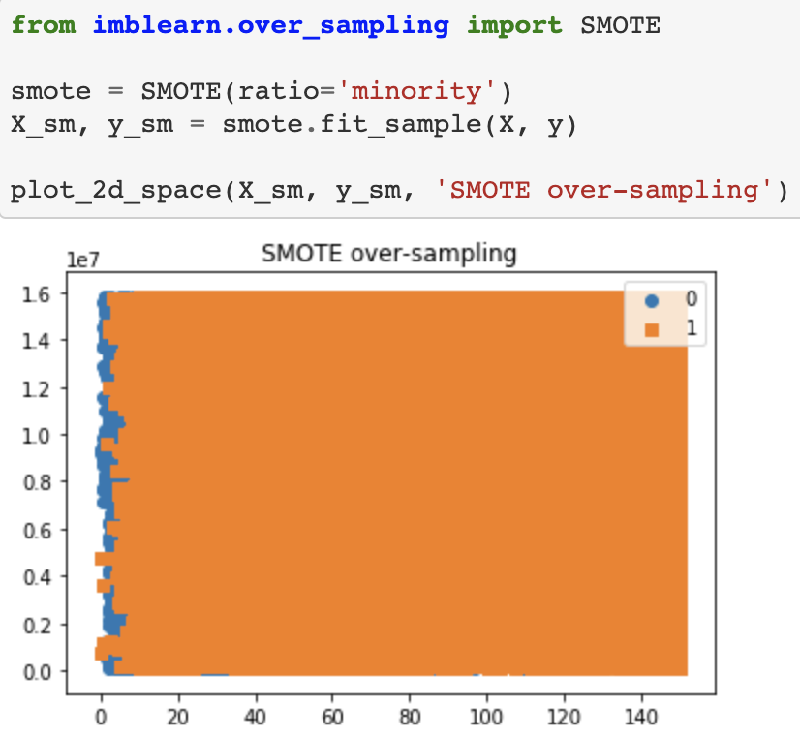
You can also use the following technique to combat class imbalance:
Random Over Sampler
Random Under Sampler
SMOTE

Slide 18
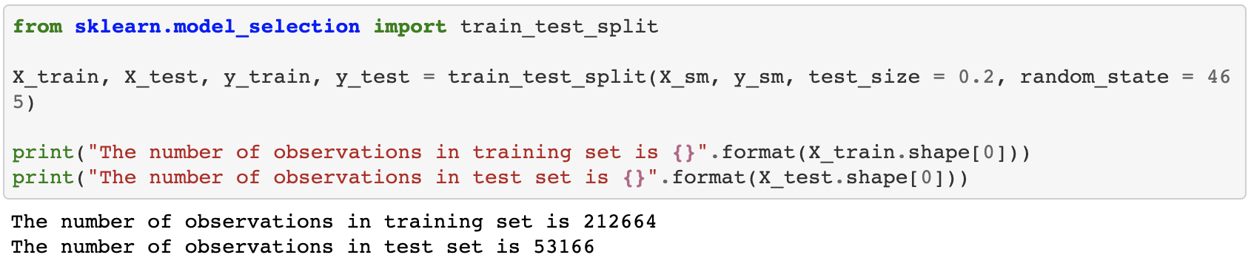
Split the data

Slide 19
Different Models

Slide 20
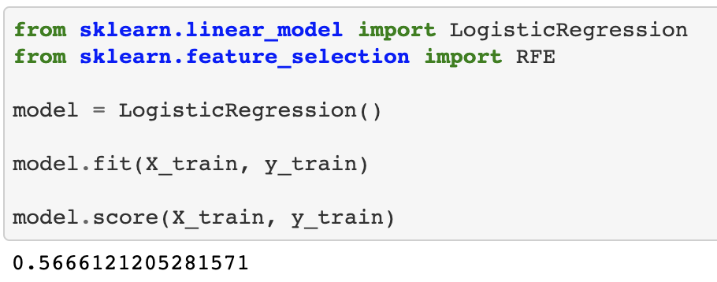
Our target data, IsFraud, has a value of 0 or 1.
LOGISTIC REGRESSION MODEL

Slide 21
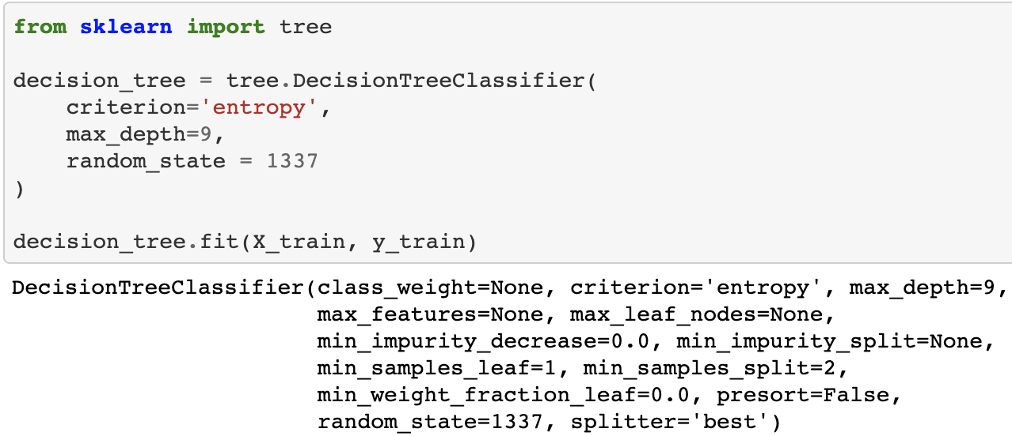
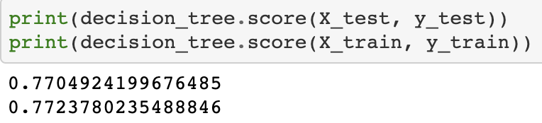
DECISION TREE MODEL

Slide 22
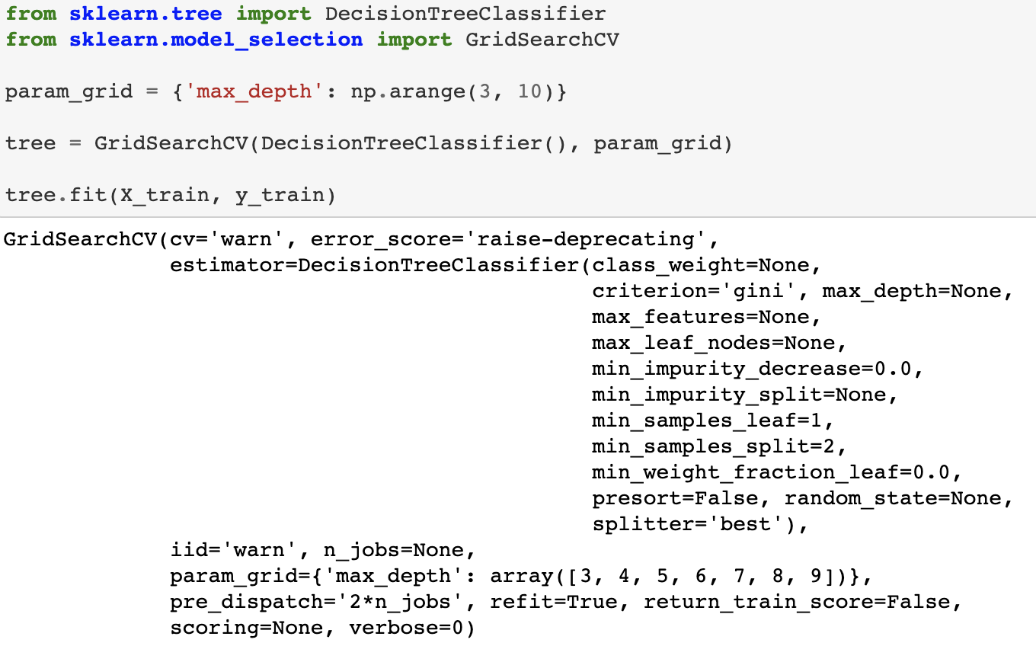
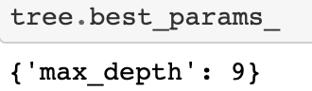
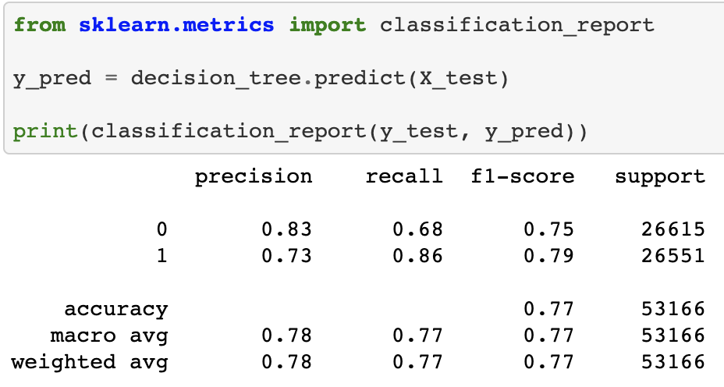
Is that the best you can do?

Slide 23
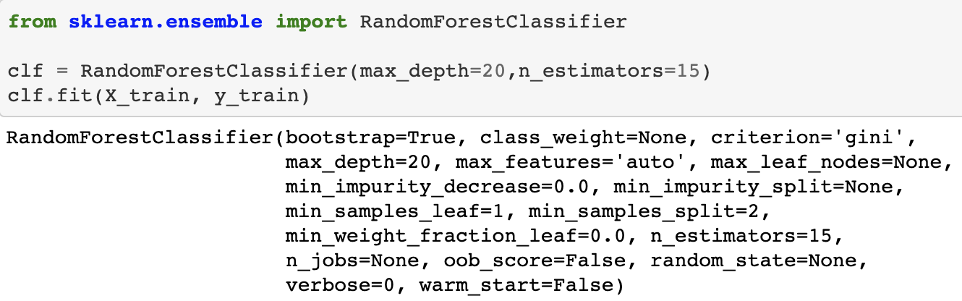
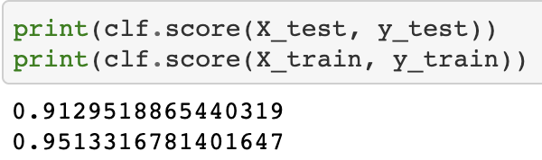
RANDOM FOREST MODEL

Slide 24
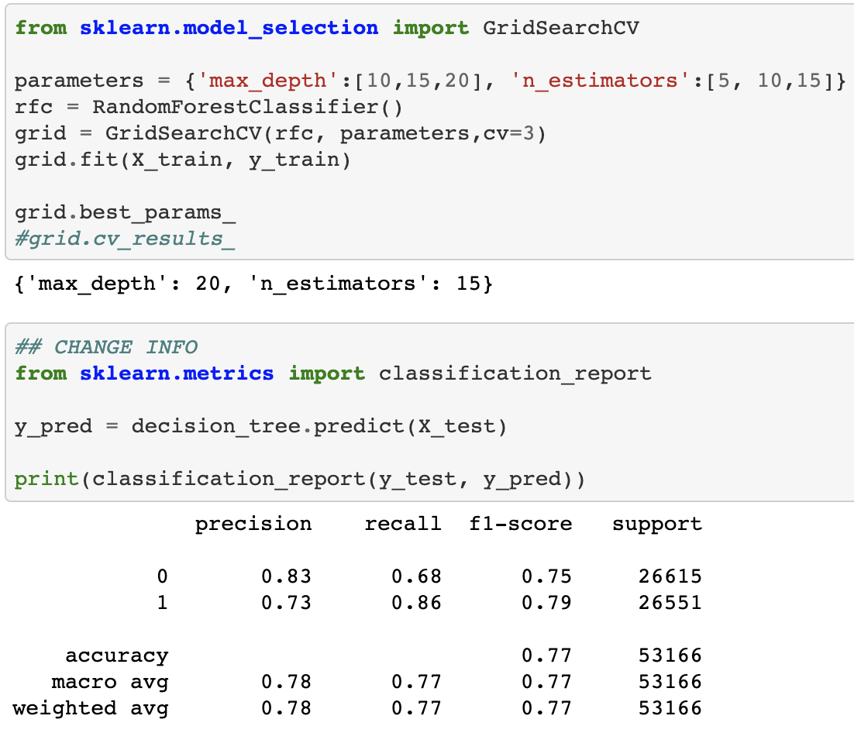
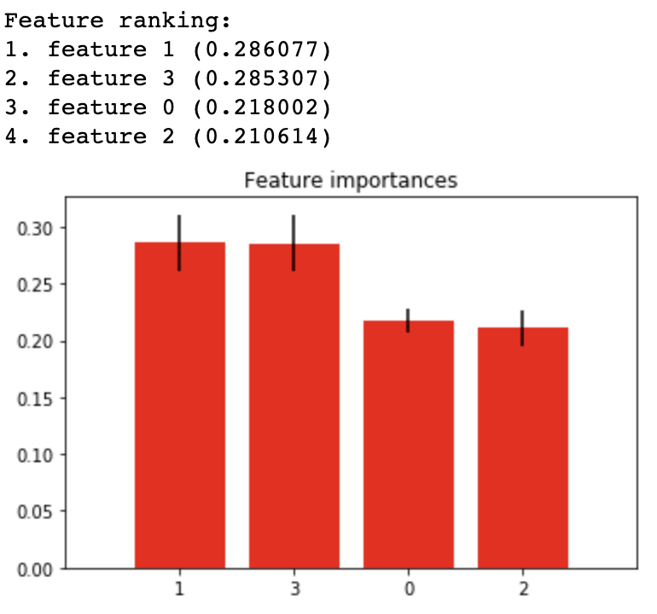

Slide 25
In summary

Slide 26
When you think it’s clean enough. Think again
If the first model didn’t work, try another one
Play around with the model’s parameters
Do you have an overfitting issue?

